Slide 2
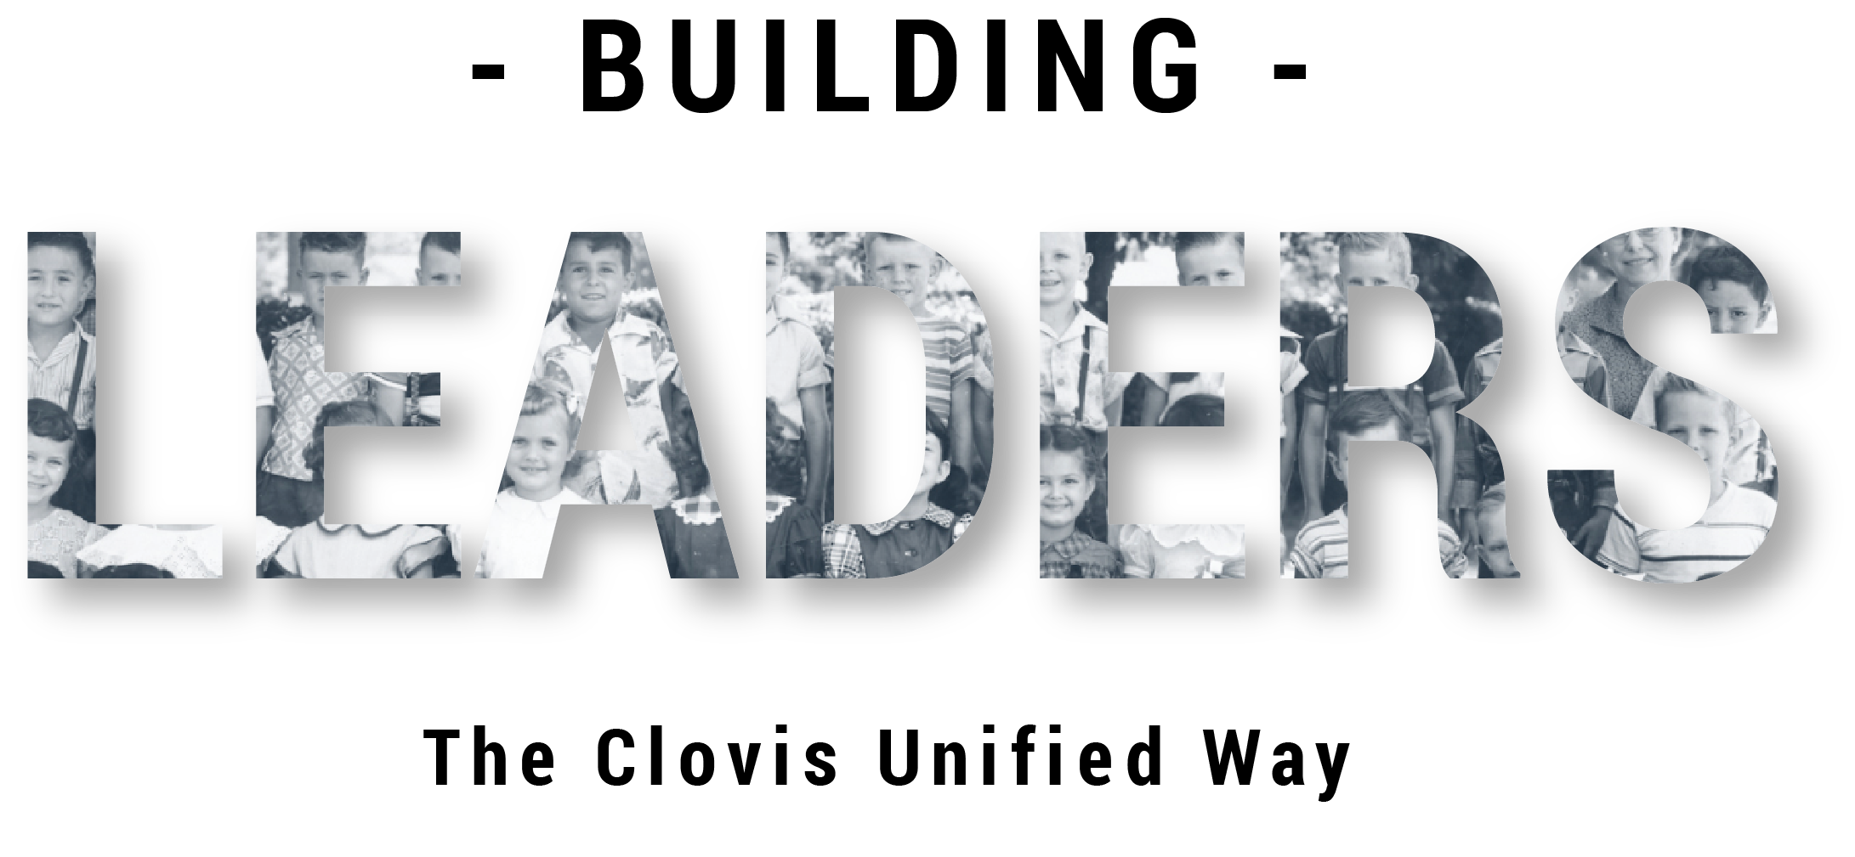
Monitoring Systems are Essential to Accomplish Goals
Notes:
Facilitator:
If this is Facilitator:
If this is the first-time participants are hearing about the Doc B Leadership Academy introduce the Academy. This is a great opportunity to build the “why” behind the “what” of leadership development based on the philosophies and values of Clovis Unified (script available in resource folder). If this is not the first time briefly review the purpose of the Leadership Academy.

Slide 3
Part III
Notes:
Facilitator:
Part III of the module is always an outside resources. It is a deep dive into our philosophies and values; where they originated, why its important today, and what it looks like in action. For the monitoring systems are essential to accomplish goals module philosophy we are using the books If You’re Riding A Horse and It Dies, Get Off and Built to Last. A summary of each book is available in the resource folder.
We will also use articles about the Plan, Do, Study, Act model. Summaries are available in the resource folder.

Slide 4
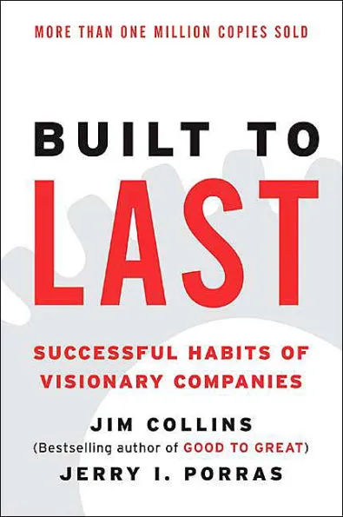
Good Enough Never is…
“COMFORT is not the objective in a visionary company. Indeed, visionary companies install powerful mechanisms to create discomfort – to obliterate complacency – and thereby stimulate change and improvement before the external world demands it.”
Collin, Built to Last, p. 187
Notes:
Script: Tier I, II, III
Facilitator:
One of the books we read at CHARGE was Good to Great by Jim Collins. According to Collins Good to Great was about turning good results into great results. His follow-up book Built to Last is about turning great results into an enduring great company. As we examine our philosophies and values it is important for us an organization to look within and determine if we are truly a good or great organization. The next question we must answer is how to make sure our philosophies and values still serve our children well into the future.
When thinking about the quote on the screen (read the quote) consider how it applies to Clovis Unified. In Clovis Unified we believe in Accountability; for ourselves, our students, and our employees. Thinking about our current accountability system, what mechanisms do we have in place that might cause discomfort? Ask participants to turn to a neighbor and share their thoughts. Facilitator should model and then ask for individual responses.
Possible answers:
CLASSI
Strategic Plan
Listening Tours
Budget Audits
Before we begin our discussions, you have a summary of Mechanisms of Discomfort from Chapter 9 of the book Built to Last titled Good Enough Never Is. As you read think about the mechanism of discomfort each great company had in place.
Discussion Points:
101 – Choose one of the companies from the summary and explain how their mechanism for discomfort is similar to something we do. Explain your thinking, using examples.
201 – How do mechanisms of discomfort serve to stimulate change and improvement. Explain your answer with examples.
301 – Choose one mechanism of discomfort that we use and answer the following:
Is it of quality? How do you know? Explain your thinking. Use examples.
Is it used? By whom? Provide examples.
Does it make a difference? How do you know. Use examples to illustrate your point.
As groups complete their discussions ask them to share their answers. If time permits, ask clarifying questions and allow for discussion.

Slide 5
Common advice from knowledgeable trainers includes the adage, “When the horse dies, dismount.” Seems simple enough. Yet, in education and business we don’t always follow that advice. Instead, we often choose from an array of other alternatives.
Let’s look at some of those alternatives.
Notes:
Script: Tiers I, II, III
Facilitator:
Part III of our Leadership modules always contains outside reading sources that make us think about the philosophy and values we are studying. Another purpose is to analyze our practices to see if they are achieving the desired results.
What an interesting concept, considering we are studying the philosophy monitoring systems are essential to accomplish a goal. Let’s read the introduction. What are some of the strategies, programs, interventions, we have used in the hope of improving student learning? Ask the audience to provide examples.

Slide 6
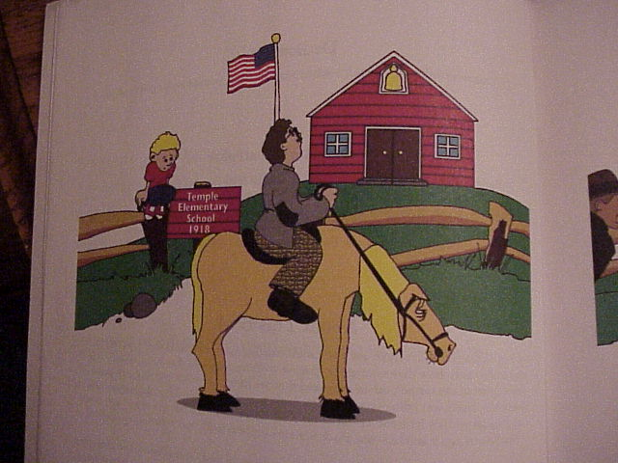
About this book…
Notes:
Script: Tiers I, II, III
Facilitator:
The authors Jim Grant and Char Forsten share “Years ago a tractor trailer truck got stuck while heading into the Boston tunnel. City officials were confounded as to how the were going to move it. Some suggested they hire a blasting crew to remove part of the tunnel; others suggested that the roof of the truck and trailer be sawed off. Meanwhile, traffic was piling up and patience was wearing then. Finally, a child stepped forward and suggested they let some air of the truck tires and back it out to a nearby exit ramp. Needless to say, it worked – the truck was removed, and traffic was soon flowing smoothly.
What does this have to do with the story you awe are about to read? School systems and businesses alike are constantly barraged with suggestions from well-intentioned people on how to make a program or initiative work when there is absolutely no hope for its success. The best alternative, as suggested in this story, is to take a fresh look at the problem and design a plan that makes sense.”

Slide 7
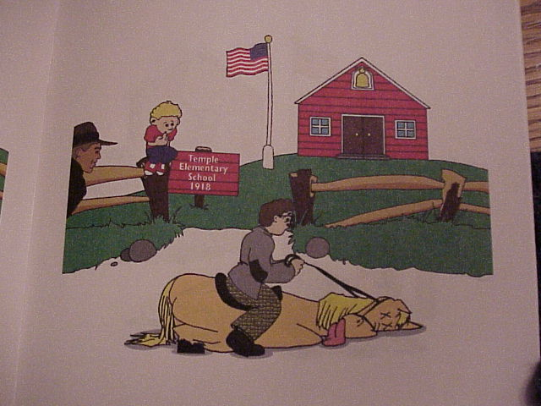
And here comes the help…
Oh no, my horse died! dies!
Notes:
Script:
Facilitator:
Read screen to participants, with expressions.
As we listen to the story keep track of the suggestions you have tried in your school and/or department.

Slide 8
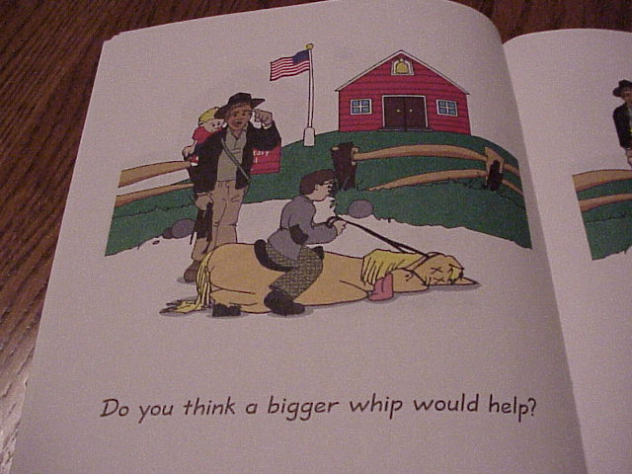
Notes:
Script: Tiers I, II, III
Facilitator:
Read the screen. What are some whips that have been recommended in education? How about business? Solicit responses from participants.

Slide 9
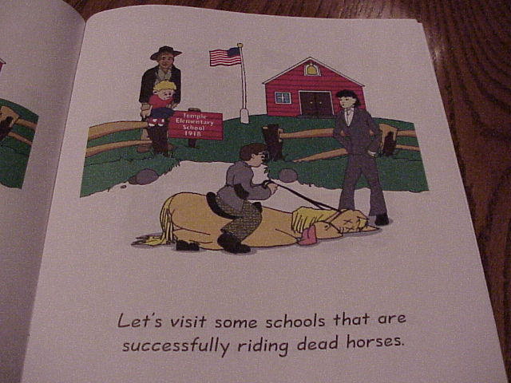
Notes:
Script: Tiers I, II, III
Facilitator:
Read the screen. Hmm… are there any schools and/or businesses successfully riding a dead horse? Solicit responses from participants.

Slide 10
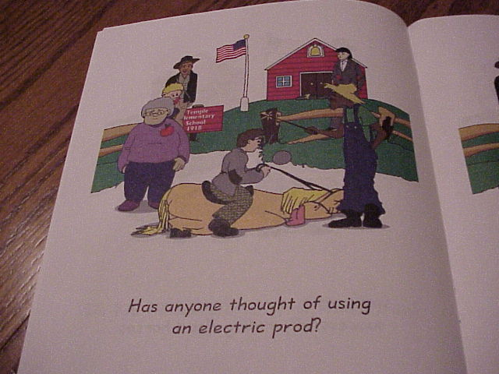
Notes:
Script: Tiers I, II, III
Facilitator:
Read the screen. Yikes, I think that would be considered assault.

Slide 11
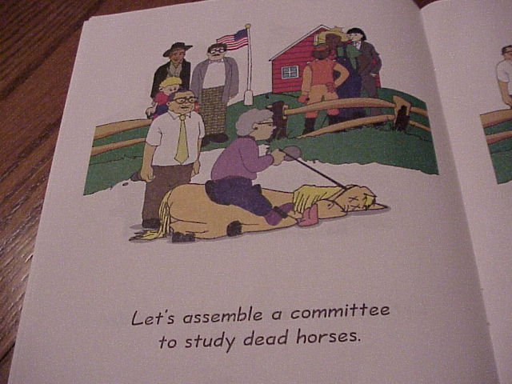
Notes:
Script: Tiers I, II, III
Facilitator:
Read the screen. We do love our committees.

Slide 12
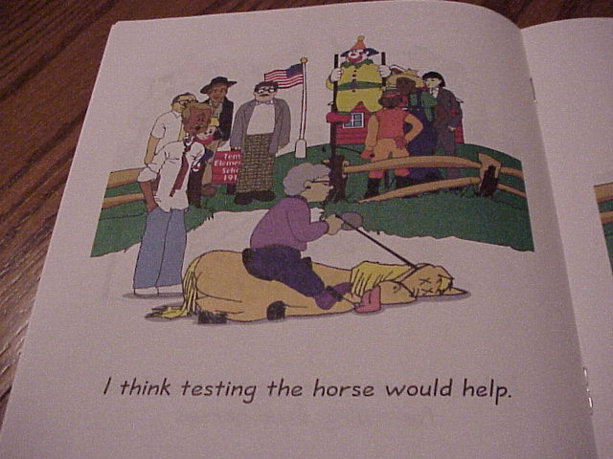
Notes:
Script: Tiers I, II, III
Facilitator:
Read the screen. Now, this is an interesting slide...

Slide 13
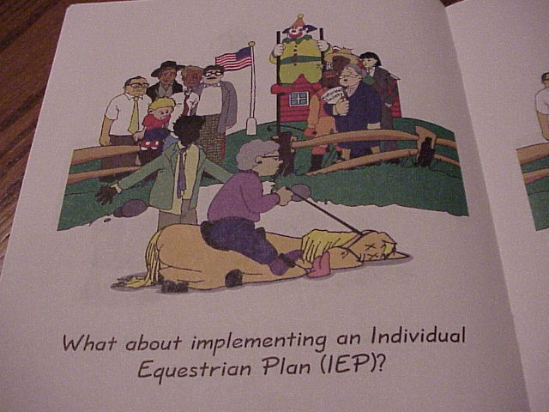
Notes:
Script: Tiers I, II, III
Facilitator:
Read the screen. We couldn’t forget our friends in SPED.

Slide 15
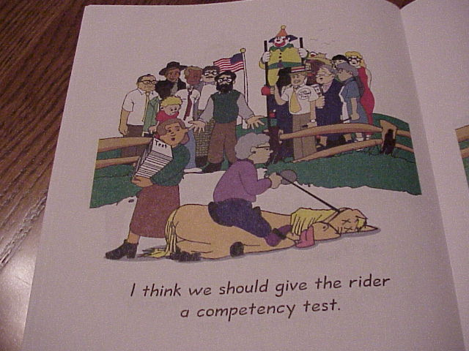
Notes:
Script: Tiers I, II, III
Facilitator:
Read the screen. What are the competency tests educators and administrators must pass? How about accountants? Do they serve a purpose? Explain your thinking. Solicit responses from participants.

Slide 16
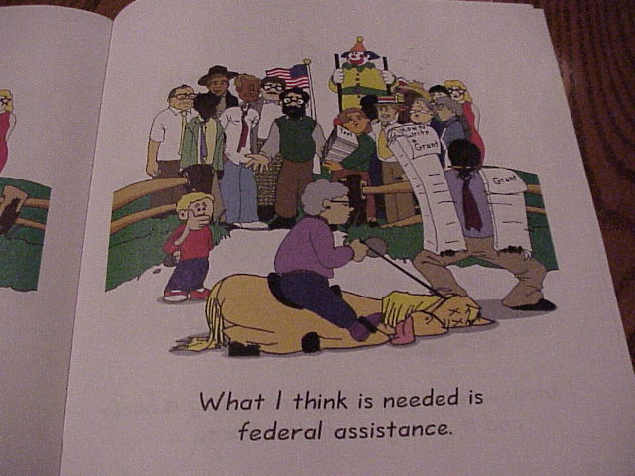
Notes:
Script: Tiers I, II, III
Facilitator:
Read the screen. Really…

Slide 17
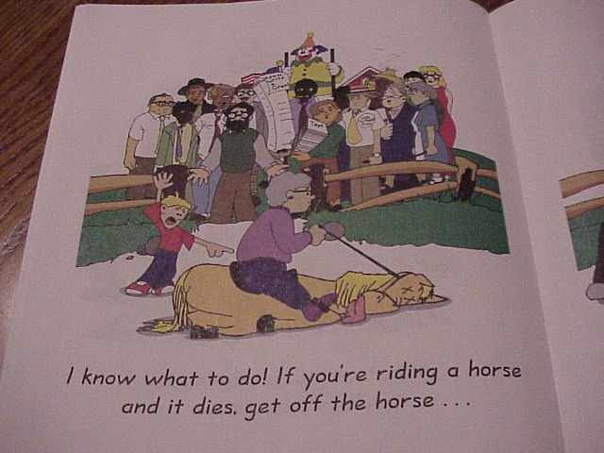
Notes:
Script: Tiers I, II, III
Facilitator:
Read the screen. Thank goodness for kids.

Slide 18
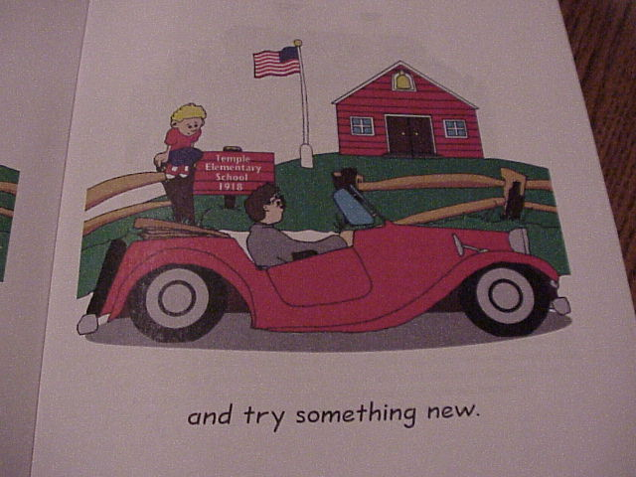

Slide 19
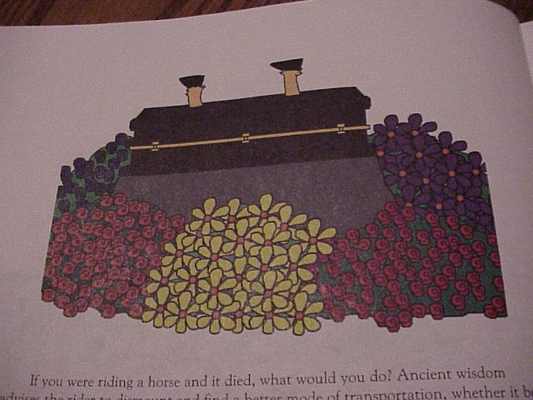
The best alternative, is to take a fresh look at the problem and design a plan that makes sense.
Notes:
Script: Tiers I, II, III
Facilitator:
Read the screen. And that is the perfect segue into our next activity.

Slide 20
Words of Wisdom
“Without data, you’re just another person with an opinion.”
“A bad system will beat a good person every time.”
“I am not reporting about people, I am reporting about practices.”
“If you do not know how to ask the right questions, you discover nothing.”
“Inspection with the aim of finding bad ones and throwing them out is too late, ineffective, and costly. Quality comes not from inspection but from the improvement of the process.” Edward Deming
Notes:
Script: Tiers I, II, III
Facilitator:
The quotes on the screen are from a gentleman named Edward Deming. In case you don’t know about Deming he was an American engineer, statistician, and management consultant. I think the quotes tie nicely with our philosophy monitoring systems are essential to accomplishing goals. Let’s take a minute to look at Deming’s quotes.
Allow participants enough time to read the quotes or you may ask for volunteers to read them one at a time. Please choose one quote that resonates with you. Turn to your neighbor and explain why it resonates and how it applies to your role in Clovis Unified.

Slide 21
Plan, Do, Study, Act
Notes:
Script: Tiers I, II, III
Facilitator:
According to Deming the PDSA Cycle (Plan-Do-Study-Act) is a systematic process for gaining valuable learning and knowledge for the continual improvement of a product, process, or service. The PDSA cycle aligns well with the philosophy monitoring systems are essential to accomplish goals. The PDSA cycle can be used in the business and educational world. There are four components to the PDSA cycle: Plan, do, Study, Act. Without analyzing data during the study phase, we cannot know how to act.
To better understand the PDSA cycle we have two articles to read. The first is a general overview of the cycle itself called Deming’s PDSA Cycle. The second is What is a PDSA Cycle? (both are available in resource folder). When reading the article look for connections between our current practices and the PDSA cycle. Pay special attention to the study and act phases.
After reading the articles form small groups to discuss one or more of the following (facilitator’s choice):
101 – What systems does CUSD have in place that align with the PDSA cycle? Explain how they are similar and different. Use examples if possible.
Possible answer: professional learning communities
201 – Thinking about your site/department what systems are in place to study the change effort? What questions do you ask to determine if the change should be implemented school/department wide?
301 – As a leader, in this district, do you see any value in implementing PDSA cycle for continuous improvement. Explain why or why not. If you see value explain how you are or would would implement the cycle.

